Slide 1


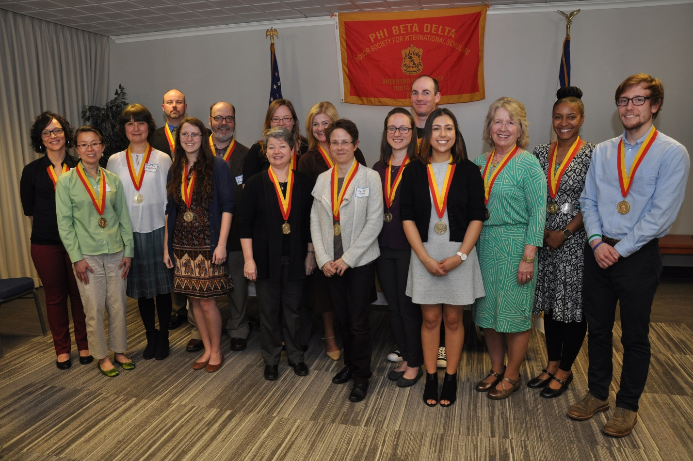


PHI BETA DELTA
HONOR SOCIETY FOR INTERNATIONAL SCHOLARS
Phi Beta Delta recognizes intellectual and professional achievement in international education, promotes the international experience such as study abroad, and supports academically based international programming such as celebration of the Chinese New Year.
Notes:
Hello…welcome! I am the International President of Phi Beta Delta Honor Society for International Scholars. It is my pleasure to share with you some details about our distinguished Society.
Phi Beta Delta recognizes intellectual and professional achievement in international education, promotes the international experience such as study abroad, and supports academically based international programming such as celebration of the Chinese New Year. Founded in 1986 at California State-Long Beach, today it is headquartered at California State-San Bernardino. It is a member of the Association of College Honor Societies.

Slide 2
Eligibility
Students, staff, faculty, and community members who meet eligibility criteria
may be nominated and inducted into the Society.
Minimum student requirements are:
30 credit hours in an associate degree program;
45 credit hours at the bachelor's degree level; or
at the graduate level: (a) one semester in a one-year master’s degree, or two semesters in a two-year master’s degree; and (b) two semesters at the doctoral level.
A minimum 3.2 GPA for undergraduates and 3.5 GPA for graduate students and demonstrated excellence in activities and/or curriculum with international themes (study abroad not required).
Staff, faculty and community members must have demonstrated excellence in teaching, scholarship, and/or service with international focus.
Notes:
Students, staff, faculty, and community members who meet eligibility criteria may be nominated and inducted into the Society. Minimum student requirements are 30 credit hours in an associate degree program; 45 credit hours at the bachelor's degree level; or at the graduate level of: (a) one semester in a one-year master’s degree, or two semesters in a two-year master’s degree; and (b) two semesters at the doctoral level. Also required, a minimum 3.2 GPA for undergraduates and 3.5 GPA for graduate students and demonstrated excellence in activities and/or curriculum with international themes (study abroad not required).

Slide 3
Benefits of Membership
Membership is life-long and life-enhancing and carries with it
many professional and personal benefits:
Professional development through an annual conference,
webinars, workshops, and special events;
Publishing opportunities in a refereed research journal;
Updates on inductions and activities in a Society newsletter;
A mentoring network;
Awards and scholarship programs;
Networking with persons with shared international interests; and
The inspiration of personal stories from around the world.
Notes:
Membership is for life and carries with it many professional and personal benefits.
Members have opportunities to grow professionally through an annual conference, webinars, workshops, and special events. The Society publishes a refereed research journal and a newsletter. We offer a mentoring network as well as awards and scholarships. Network with persons with similar international interests and become inspired by personal stories.

Slide 4

Chartering a Chapter
We invite applications for new chapters to be chartered at 2-year
and 4-year colleges and universities anywhere in the world. The institutional commitment is a one-time petitioning and application fee
of $350, which is submitted along with a supporting letter from the administration. Chapters determine annual dues.
We would be pleased to guide any institution interested in developing a chapter. Our Society website provides full information:
www.phibetadelta.org
Notes:
We invite applications for new chapters to be chartered at 2-year and 4-year colleges and universities anywhere in the world. The institutional commitment is a one-time petitioning/application fee of $350, which is submitted along with a supporting letter from the administration. Chapters determine annual dues.
We would be pleased to guide any institution interested in developing a chapter. Our Society website provides full information: www.phibetadelta.org

Slide 5
The Induction Ceremony
Welcome
Introduction of special guests, recipients, and chapter board
A summary of the purpose of the honor society
A description of the Greek letters, colors, and medallion
Introduction of the keynote speaker
Speaker’s address
A reading of the Statement of Induction
Reading of the bio of each nominee, followed by conferring
of the medallion and certificate
Closing remarks
Group photograph and reception
Notes:
Students, staff, and faculty nominated for membership in Phi Beta Delta must be formally inducted into the honor society.
The induction ceremony normally has the following components:
Welcome
Introduction of special guests, recipients, and chapter board
A summary of the purpose of the honor society
A description of the Greek letters, colors, and medallion
Introduction of the keynote speaker and speaker’s address
A reading of the Statement of Induction
Reading of the bio of each nominee, followed by conferring of the medallion and certificate
Closing remarks
Group photograph and reception
The ceremony is typically followed by a press release with the group photograph. A report with a list of new members is filed with the national office.

